Slide 1
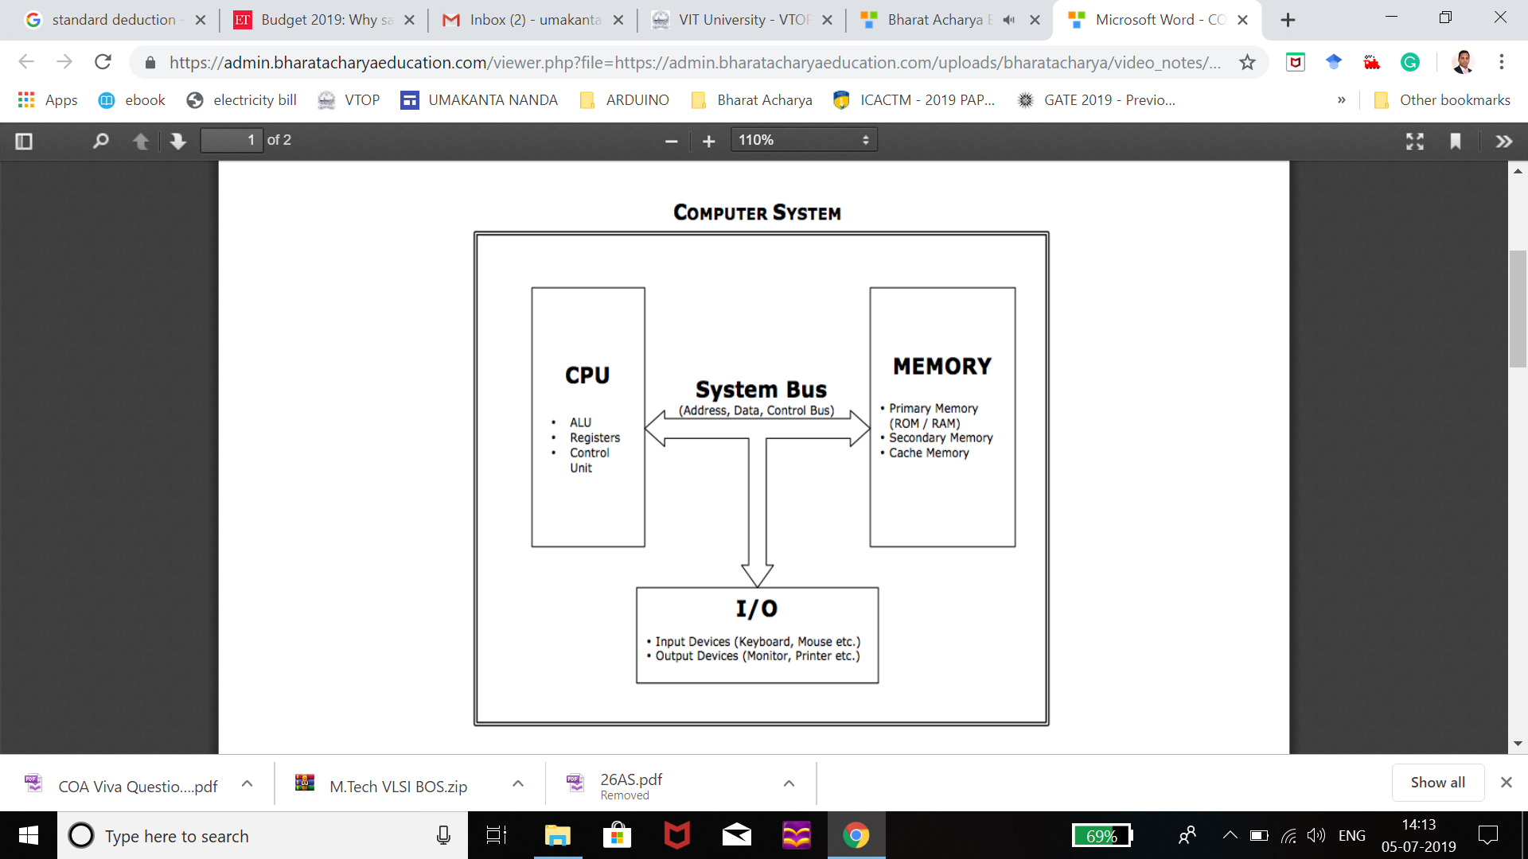

Slide 2
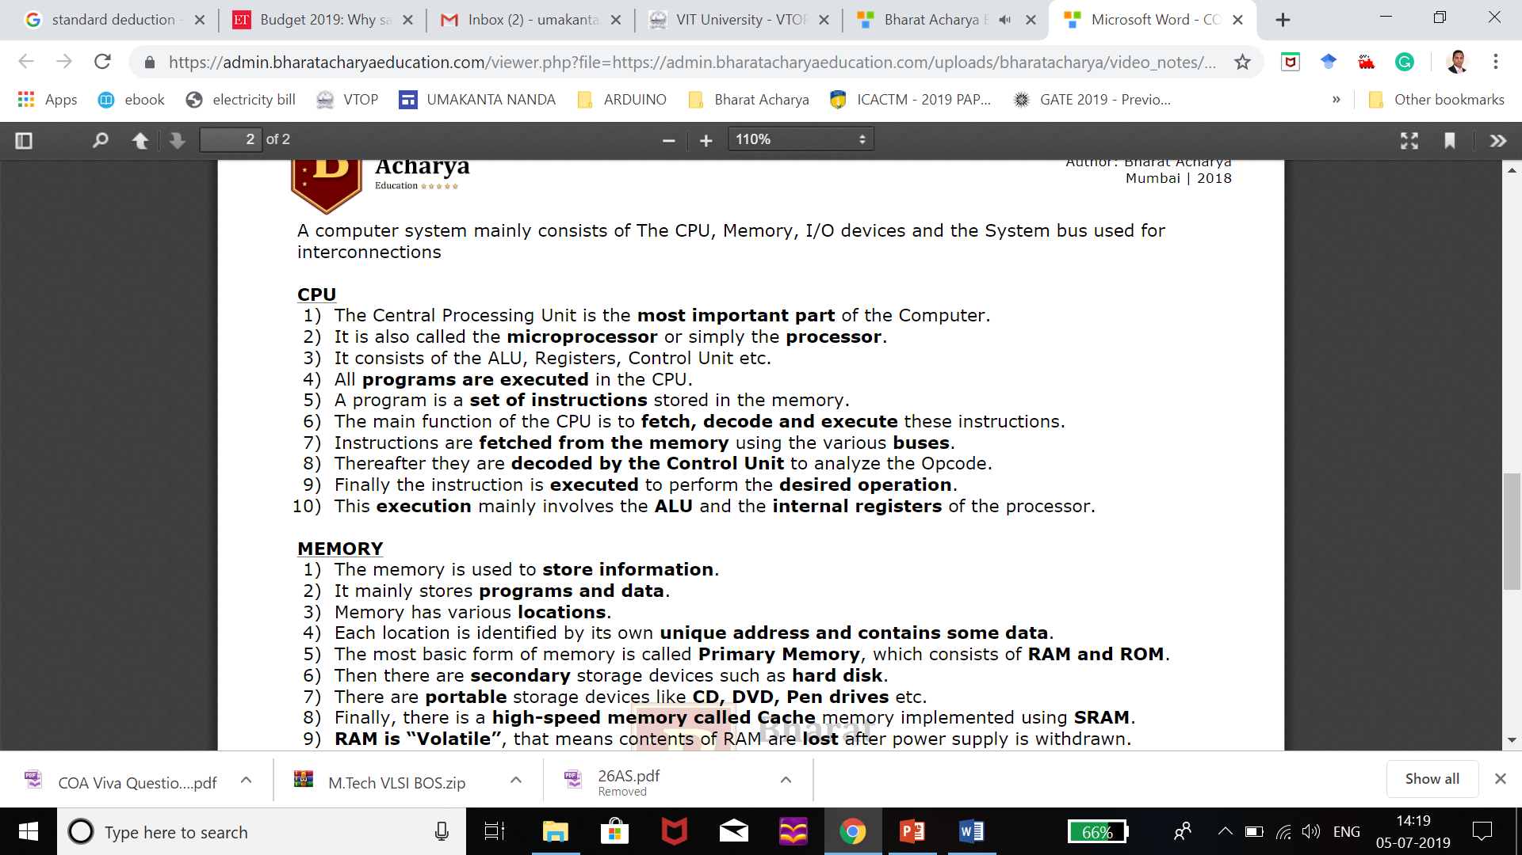

Slide 3
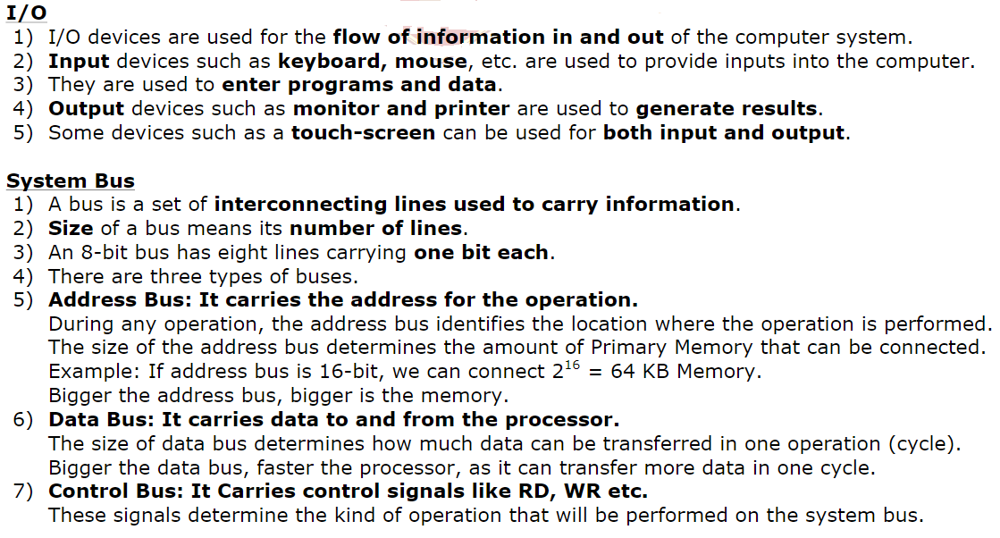
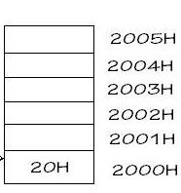

Slide 4
Architecture & Organization
Architecture is those attributes visible to the programmer
Instruction set, number of bits used for data representation, I/O mechanisms, addressing techniques.
e.g. Is there a multiply instruction?
Computer Architecture is also referred as Instruction set architecture (ISA) which has an algorithm to control various components.
Organization is how features are implemented by interconnecting the operational units to realize the specific architectural specifications.
Control signals, interfaces, memory technology.
e.g. Is there a hardware multiply unit or is it done by repeated addition?
All Intel x86 family share the same basic architecture
The IBM System/370 family share the same basic architecture
This gives code compatibility
Organization differs between different versions
Ex: Pipelining
ISA
Instruction format
Instruction opcode
Register
Instruction and Data memory

Slide 5
Structure & Function
Structure is the way in which components relate to each other
Function is the operation of individual components as
Function
Data processing
Data storage
Data movement
Control
Structure
CPU
Main memory
I/O
System interconnection
Notes:
<number>

Slide 6
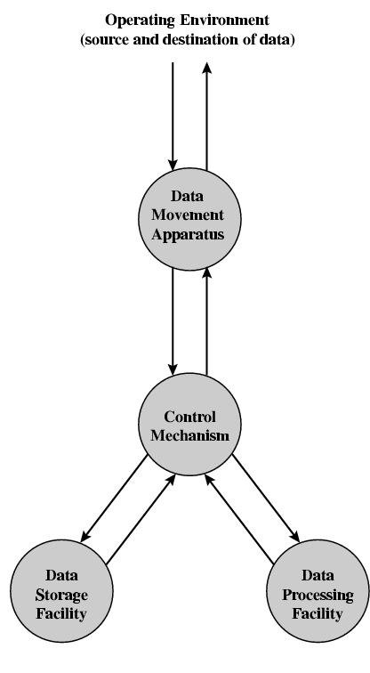
Function
All computer functions are:
Data processing
Data storage
Data movement
Control
Notes:
<number>

Slide 7
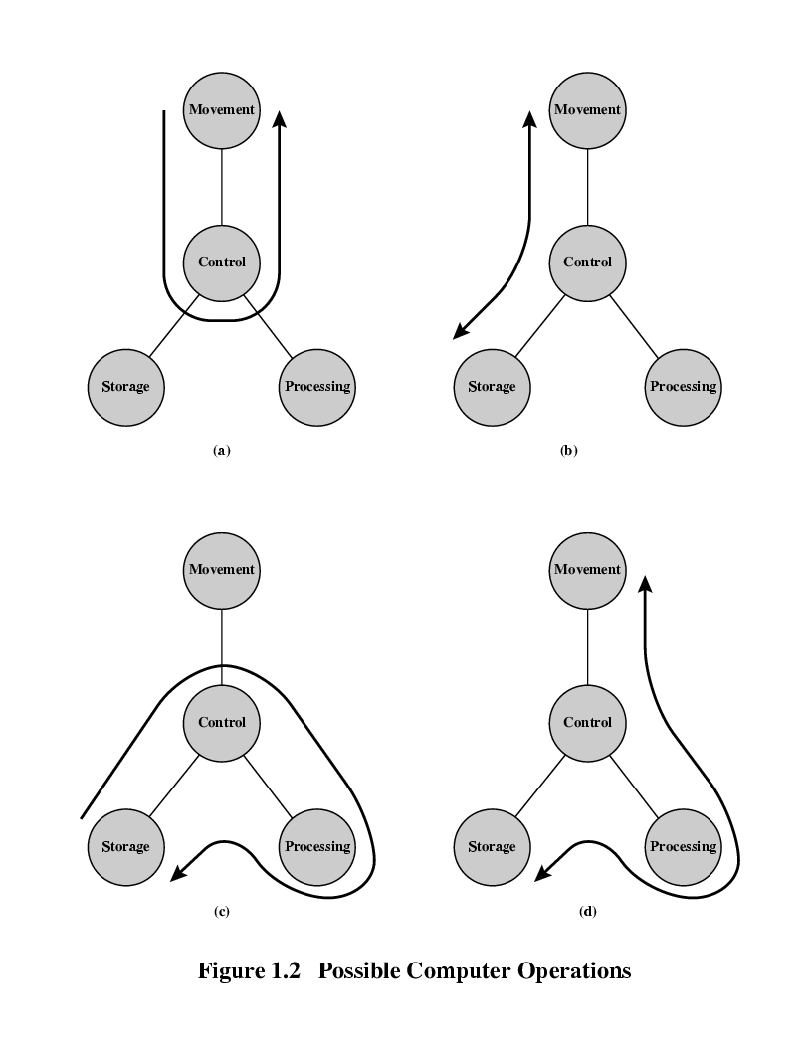
Operations (1) Data movement
Notes:
<number>

Slide 8
Operations (2) Storage
Notes:
<number>

Slide 9
Operation (3) Processing from/to storage
Notes:
<number>

Slide 10
Operation (4) Processing from storage to I/O
Notes:
<number>

Slide 11
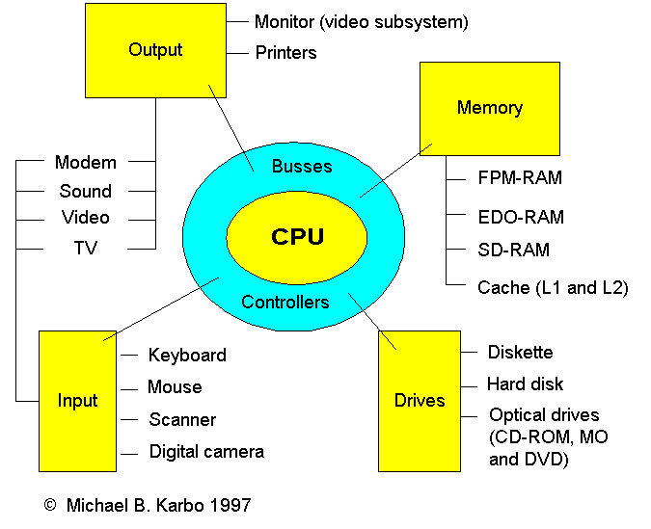
Structure
The Computer
CPU
Controls the operation of the computer and performs its data processing functions.
Main memory
Stores data
Fast Page Mode RAM
Synchronous DRAM
Extended data output RAM
I/O
Moves data between the computer and its external environment
System interconnection
Provides for communication among CPU, main memory, and I/O

Slide 12
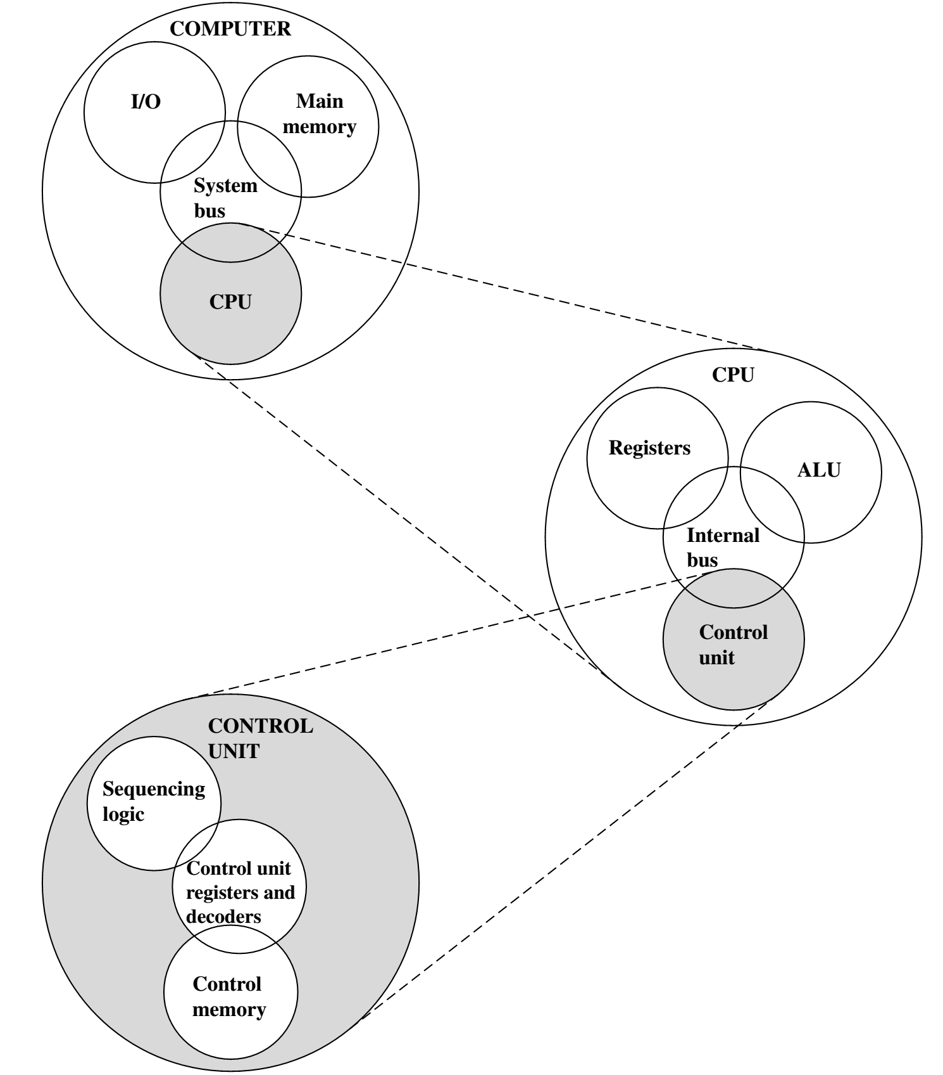
Structure - Top Level
Notes:
<number>

Slide 13
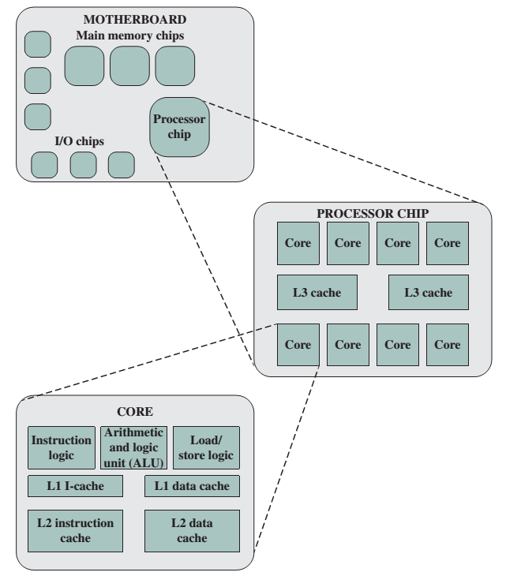
Multicore computer

